Slide 1



Enjoy our free templates!
slidelizard.com

Slide 2


Who wants to be a Millionaire
Template Tutorial
Please read this short tutorial as a guide to show you how to get the best quizzing experience!
Version A – Play with SlideLizard
RECOMMENDED
Playing with SlideLizard has many benefits – you can add live quizzes and let your participants vote via smartphone and see the results! You can download SlideLizard for free here: slidelizard.com/download
Once you downloaded it, you need to connect this presentation with SlideLizard. If you need help, please watch our tutorial video: youtube.com
On the next slide, you‘ll learn how to create questions that will be shown directly in the right boxes on the slides.

Slide 3
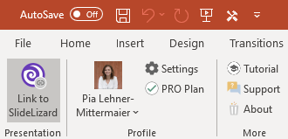
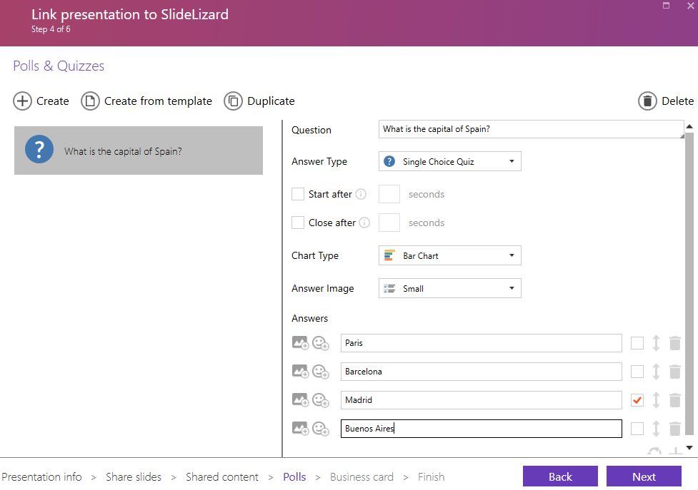

1. Click Link to SlideLizard
2. Under Polls and Quizzes, you can create quiz questions. Create as many questions as there are in the template (that is 14)
Your created questions will appear here
Always use „Single Choice Quiz“
Type in exactly 4 answers and tick the correct one

Slide 4
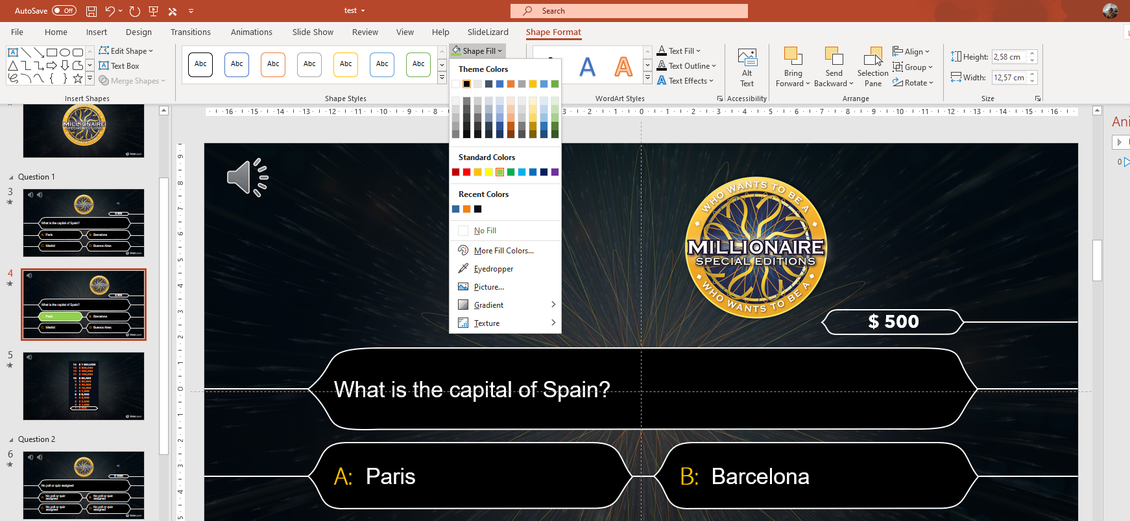
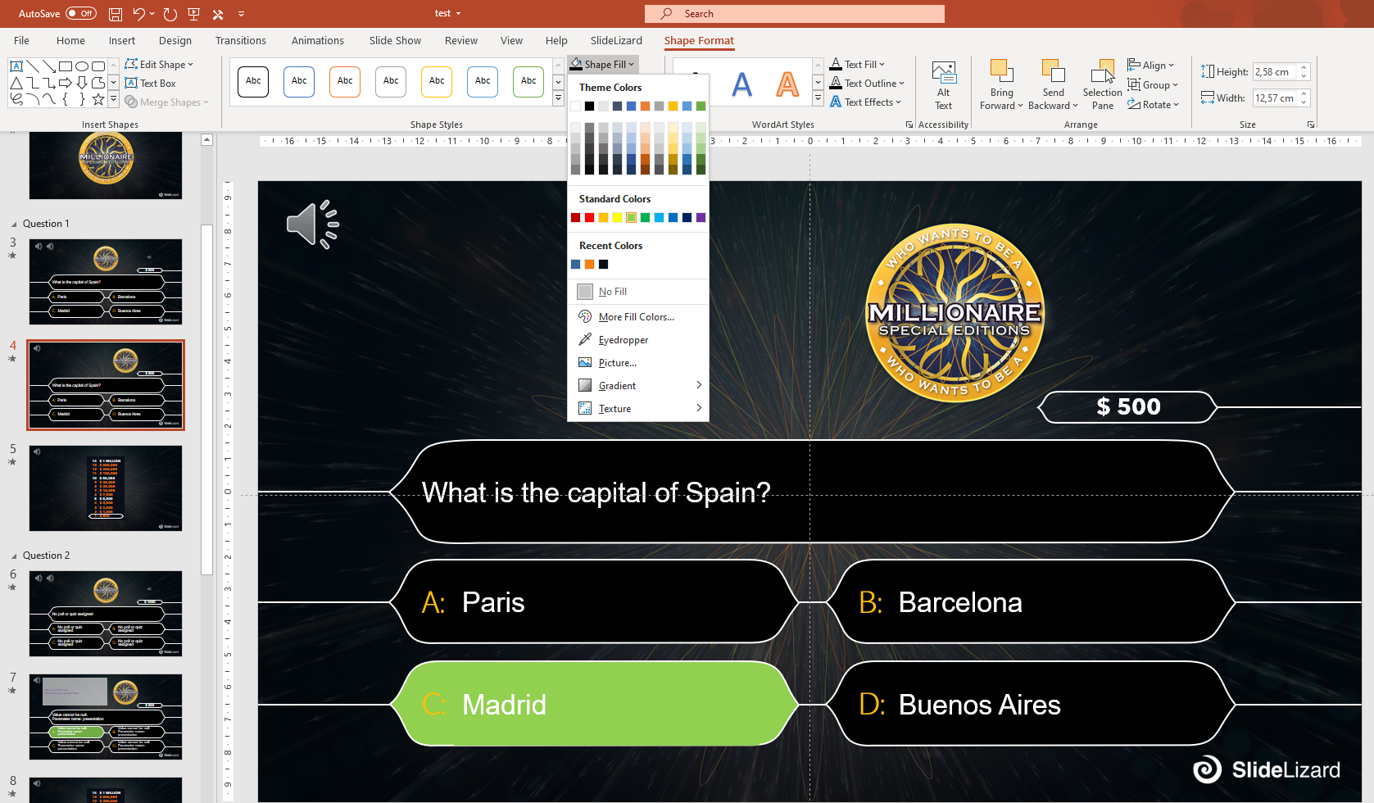
3. Mark the correct answer
3.1 Go to an answer slide. Click on the box with the answer that is preset as green. Go to Shape Format and under Shape Fill, select the black color.
3.2 Click on the box that contains the right answer. Under Shape Fill, select the light green color
Previously green box, now filled black

Slide 5
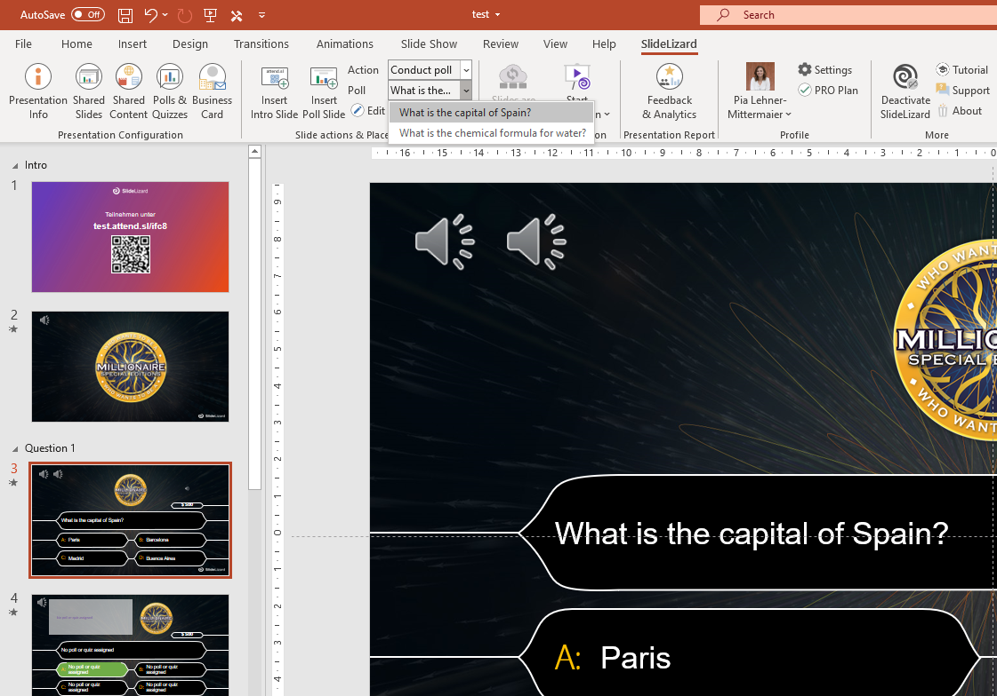
4. Go to the slide where you want to add your question, set Action: Conduct poll; Poll: pick one of the questions you previously created here
5. On the next slide (answer slide!), set Action: Show poll results; Poll: pick the question from the previous slide
6. Now it‘s time to play! If you need help on how to conduct the presentation, please watch: https://www.youtube.com/watch?v=xJNWM34J-YA
4. This is where all your created polls appear. Choose the one you want, click on it and your question + answers will be added automatically!

Slide 6
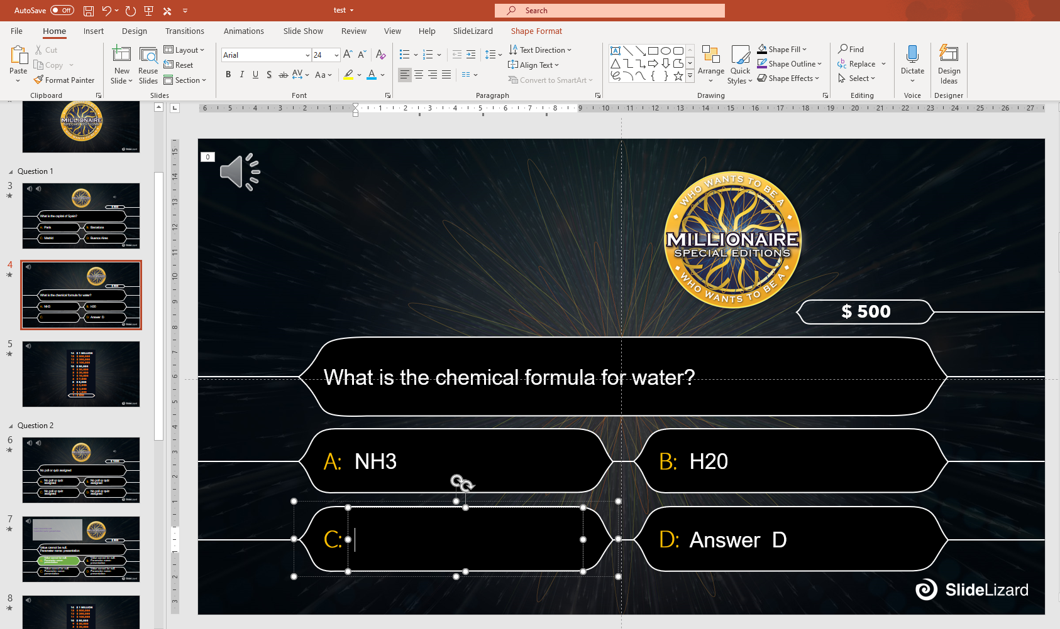
Version B – Play without SlideLizard
You can do the quiz without SlideLizard as well. To do so, click on the predefined Slides and change the Text in the question and answer boxes manually.
To learn how to mark the correct answer, go to slide 3 (Point 3) of Version A.

Slide 7

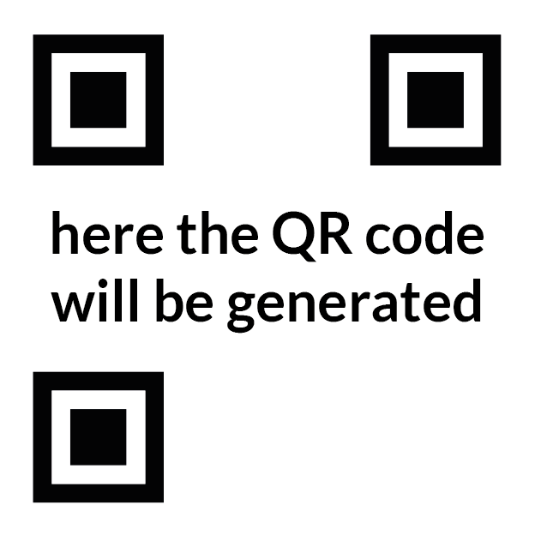

Who wants to be a millionaire
Open the participation URL on your smartphone
Enter your name
Each correctly answered question earns 1 point
Participation URL:
Here the URL will be generated after connecting with SlideLizard

Slide 8


Slide 9
$ 500
No poll or quiz assigned
No poll or quiz assigned
No poll or quiz assigned
A:
B:
No poll or quiz assigned
No poll or quiz assigned
C:
D:

Slide 10
$ 500
No poll or quiz assigned
No poll or quiz assigned
No poll or quiz assigned
A:
B:
No poll or quiz assigned
No poll or quiz assigned
C:
D:

Slide 11
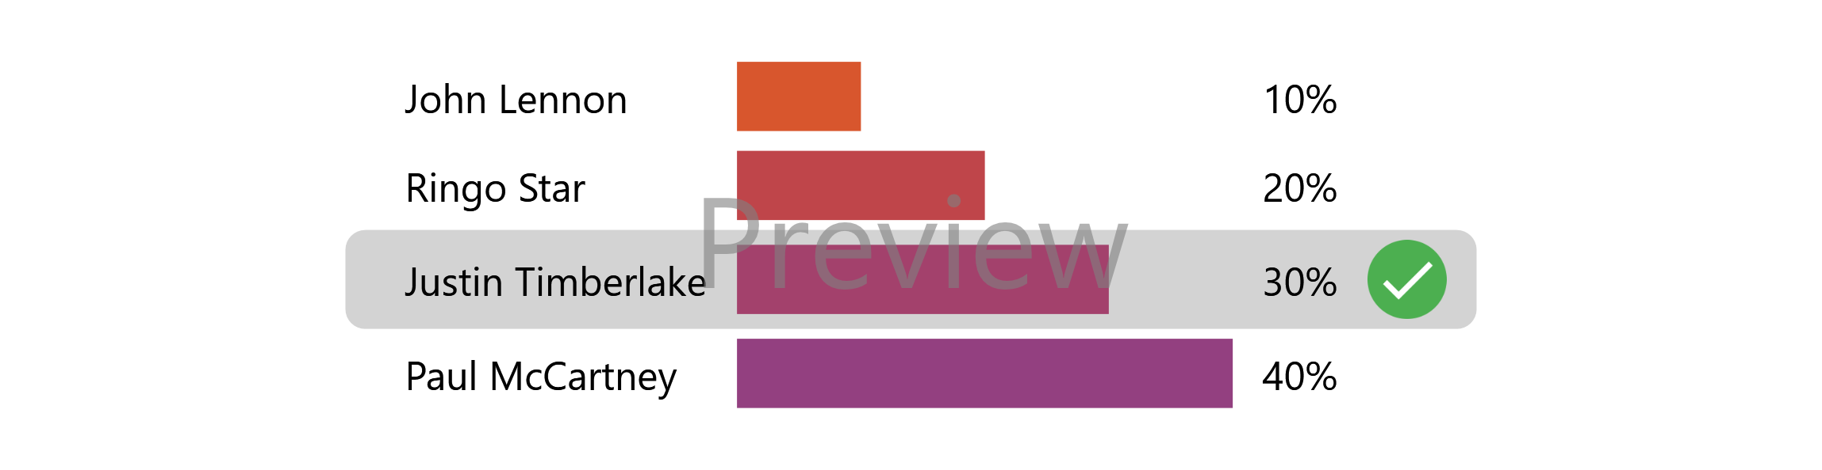
No poll or quiz assigned
No poll or quiz assigned

Slide 12
14
13
12
11
10
9
8
7
6
5
4
3
2
1
$ 1 MILLION
$ 500,000
$ 250,000
$ 100,000
$ 50,000
$ 30,000
$ 20,000
$ 10,000
$ 7,000
$ 5,000
$ 3,000
$ 2,000
$ 1,000
$ 500

Slide 13
$ 1000
No poll or quiz assigned
No poll or quiz assigned
No poll or quiz assigned
A:
B:
No poll or quiz assigned
No poll or quiz assigned
C:
D:

Slide 14
$ 1000
No poll or quiz assigned
No poll or quiz assigned
No poll or quiz assigned
A:
B:
No poll or quiz assigned
No poll or quiz assigned
C:
D:

Slide 15

No poll or quiz assigned
No poll or quiz assigned

Slide 16
14
13
12
11
10
9
8
7
6
5
4
3
2
1
$ 1 MILLION
$ 500,000
$ 250,000
$ 100,000
$ 50,000
$ 30,000
$ 20,000
$ 10,000
$ 7,000
$ 5,000
$ 3,000
$ 2,000
$ 1,000
$ 500

Slide 17
$ 2000
No poll or quiz assigned
No poll or quiz assigned
No poll or quiz assigned
A:
B:
No poll or quiz assigned
No poll or quiz assigned
C:
D:

Slide 18
$ 2000
No poll or quiz assigned
No poll or quiz assigned
No poll or quiz assigned
A:
B:
No poll or quiz assigned
No poll or quiz assigned
C:
D:

Slide 19
No poll or quiz assigned
No poll or quiz assigned

Slide 20
14
13
12
11
10
9
8
7
6
5
4
3
2
1
$ 1 MILLION
$ 500,000
$ 250,000
$ 100,000
$ 50,000
$ 30,000
$ 20,000
$ 10,000
$ 7,000
$ 5,000
$ 3,000
$ 2,000
$ 1,000
$ 500

Slide 21
$ 3000
No poll or quiz assigned
No poll or quiz assigned
No poll or quiz assigned
A:
B:
No poll or quiz assigned
No poll or quiz assigned
C:
D:

Slide 22
$ 3000
No poll or quiz assigned
No poll or quiz assigned
No poll or quiz assigned
A:
B:
No poll or quiz assigned
No poll or quiz assigned
C:
D:

Slide 23
No poll or quiz assigned
No poll or quiz assigned

Slide 24
14
13
12
11
10
9
8
7
6
5
4
3
2
1
$ 1 MILLION
$ 500,000
$ 250,000
$ 100,000
$ 50,000
$ 30,000
$ 20,000
$ 10,000
$ 7,000
$ 5,000
$ 3,000
$ 2,000
$ 1,000
$ 500

Slide 25
$ 5000
No poll or quiz assigned
No poll or quiz assigned
No poll or quiz assigned
A:
B:
No poll or quiz assigned
No poll or quiz assigned
C:
D:

Slide 26
$ 5000
No poll or quiz assigned
No poll or quiz assigned
No poll or quiz assigned
A:
B:
No poll or quiz assigned
No poll or quiz assigned
C:
D:

Slide 27
No poll or quiz assigned
No poll or quiz assigned

Slide 28
14
13
12
11
10
9
8
7
6
5
4
3
2
1
$ 1 MILLION
$ 500,000
$ 250,000
$ 100,000
$ 50,000
$ 30,000
$ 20,000
$ 10,000
$ 7,000
$ 5,000
$ 3,000
$ 2,000
$ 1,000
$ 500

Slide 29
$ 7000
No poll or quiz assigned
No poll or quiz assigned
No poll or quiz assigned
A:
B:
No poll or quiz assigned
No poll or quiz assigned
C:
D:

Slide 30
$ 7000
No poll or quiz assigned
No poll or quiz assigned
No poll or quiz assigned
A:
B:
No poll or quiz assigned
No poll or quiz assigned
C:
D:

Slide 31
No poll or quiz assigned
No poll or quiz assigned

Slide 32
14
13
12
11
10
9
8
7
6
5
4
3
2
1
$ 1 MILLION
$ 500,000
$ 250,000
$ 100,000
$ 50,000
$ 30,000
$ 20,000
$ 10,000
$ 7,000
$ 5,000
$ 3,000
$ 2,000
$ 1,000
$ 500

Slide 33
$ 10,000
No poll or quiz assigned
No poll or quiz assigned
No poll or quiz assigned
A:
B:
No poll or quiz assigned
No poll or quiz assigned
C:
D:

Slide 34
$ 10,000
No poll or quiz assigned
No poll or quiz assigned
No poll or quiz assigned
A:
B:
No poll or quiz assigned
No poll or quiz assigned
C:
D:

Slide 35
No poll or quiz assigned
No poll or quiz assigned

Slide 36
14
13
12
11
10
9
8
7
6
5
4
3
2
1
$ 1 MILLION
$ 500,000
$ 250,000
$ 100,000
$ 50,000
$ 30,000
$ 20,000
$ 10,000
$ 7,000
$ 5,000
$ 3,000
$ 2,000
$ 1,000
$ 500

Slide 37
$ 20,000
No poll or quiz assigned
No poll or quiz assigned
No poll or quiz assigned
A:
B:
No poll or quiz assigned
No poll or quiz assigned
C:
D:

Slide 38
$ 20,000
No poll or quiz assigned
No poll or quiz assigned
No poll or quiz assigned
A:
B:
No poll or quiz assigned
No poll or quiz assigned
C:
D:

Slide 39
No poll or quiz assigned
No poll or quiz assigned

Slide 40
14
13
12
11
10
9
8
7
6
5
4
3
2
1
$ 1 MILLION
$ 500,000
$ 250,000
$ 100,000
$ 50,000
$ 30,000
$ 20,000
$ 10,000
$ 7,000
$ 5,000
$ 3,000
$ 2,000
$ 1,000
$ 500

Slide 41
$ 30,000
No poll or quiz assigned
No poll or quiz assigned
No poll or quiz assigned
A:
B:
No poll or quiz assigned
No poll or quiz assigned
C:
D:

Slide 42
$ 30,000
No poll or quiz assigned
No poll or quiz assigned
No poll or quiz assigned
A:
B:
No poll or quiz assigned
No poll or quiz assigned
C:
D:

Slide 43
No poll or quiz assigned
No poll or quiz assigned

Slide 44
14
13
12
11
10
9
8
7
6
5
4
3
2
1
$ 1 MILLION
$ 500,000
$ 250,000
$ 100,000
$ 50,000
$ 30,000
$ 20,000
$ 10,000
$ 7,000
$ 5,000
$ 3,000
$ 2,000
$ 1,000
$ 500

Slide 45
$ 50,000
No poll or quiz assigned
No poll or quiz assigned
No poll or quiz assigned
A:
B:
No poll or quiz assigned
No poll or quiz assigned
C:
D:

Slide 46
$ 50,000
No poll or quiz assigned
No poll or quiz assigned
No poll or quiz assigned
A:
B:
No poll or quiz assigned
No poll or quiz assigned
C:
D:

Slide 47
No poll or quiz assigned
No poll or quiz assigned

Slide 48
14
13
12
11
10
9
8
7
6
5
4
3
2
1
$ 1 MILLION
$ 500,000
$ 250,000
$ 100,000
$ 50,000
$ 30,000
$ 20,000
$ 10,000
$ 7,000
$ 5,000
$ 3,000
$ 2,000
$ 1,000
$ 500

Slide 49
$ 100,000
No poll or quiz assigned
No poll or quiz assigned
No poll or quiz assigned
A:
B:
No poll or quiz assigned
No poll or quiz assigned
C:
D:

Slide 50
$ 100,000
No poll or quiz assigned
No poll or quiz assigned
No poll or quiz assigned
A:
B:
No poll or quiz assigned
No poll or quiz assigned
C:
D:

Slide 51
No poll or quiz assigned
No poll or quiz assigned

Slide 52
14
13
12
11
10
9
8
7
6
5
4
3
2
1
$ 1 MILLION
$ 500,000
$ 250,000
$ 100,000
$ 50,000
$ 30,000
$ 20,000
$ 10,000
$ 7,000
$ 5,000
$ 3,000
$ 2,000
$ 1,000
$ 500

Slide 53
$ 250,000
No poll or quiz assigned
No poll or quiz assigned
No poll or quiz assigned
A:
B:
No poll or quiz assigned
No poll or quiz assigned
C:
D:

Slide 54
$ 250,000
No poll or quiz assigned
No poll or quiz assigned
No poll or quiz assigned
A:
B:
No poll or quiz assigned
No poll or quiz assigned
C:
D:

Slide 55
No poll or quiz assigned
No poll or quiz assigned

Slide 56
14
13
12
11
10
9
8
7
6
5
4
3
2
1
$ 1 MILLION
$ 500,000
$ 250,000
$ 100,000
$ 50,000
$ 30,000
$ 20,000
$ 10,000
$ 7,000
$ 5,000
$ 3,000
$ 2,000
$ 1,000
$ 500

Slide 57
$ 500,000
No poll or quiz assigned
No poll or quiz assigned
No poll or quiz assigned
A:
B:
No poll or quiz assigned
No poll or quiz assigned
C:
D:

Slide 58
$ 500,000
No poll or quiz assigned
No poll or quiz assigned
No poll or quiz assigned
A:
B:
No poll or quiz assigned
No poll or quiz assigned
C:
D:

Slide 59
No poll or quiz assigned
No poll or quiz assigned

Slide 60
14
13
12
11
10
9
8
7
6
5
4
3
2
1
$ 1 MILLION
$ 500,000
$ 250,000
$ 100,000
$ 50,000
$ 30,000
$ 20,000
$ 10,000
$ 7,000
$ 5,000
$ 3,000
$ 2,000
$ 1,000
$ 500

Slide 61
$ 1 MILLION
No poll or quiz assigned
No poll or quiz assigned
No poll or quiz assigned
A:
B:
No poll or quiz assigned
No poll or quiz assigned
C:
D:

Slide 62
$ 1 MILLION
No poll or quiz assigned
No poll or quiz assigned
No poll or quiz assigned
A:
B:
No poll or quiz assigned
No poll or quiz assigned
C:
D:

Slide 63
No poll or quiz assigned
No poll or quiz assigned

Slide 64
Who wants to be a Millionaire– Links for Sound Download
https://millionaire.fandom.com/wiki/Music_scores
Main Theme: https://www.soundboard.com/sb/sound/904527
Wrong answer: https://www.soundboard.com/sb/sound/904547
Right answer: https://www.soundboard.com/sb/sound/904544
Call a friend: https://www.soundboard.com/sb/sound/904546
1.000.000 music: https://www.soundboard.com/sb/sound/904542
500.000 music: https://www.soundboard.com/sb/sound/904541
125.000 music: https://www.soundboard.com/sb/sound/904540
64.000 music: https://www.soundboard.com/sb/sound/904539
2.000 – 30.000 music: https://www.soundboard.com/sb/sound/904538
50 – 1000 music: https://www.soundboard.com/sb/sound/904537
Start sound: https://www.soundboard.com/sb/sound/904536

Slide 65
Read our blogpost for more information:
https://slidelizard.com/blog/who-wants-to-be-a-millionaire-powerpoint-template

Slide 66


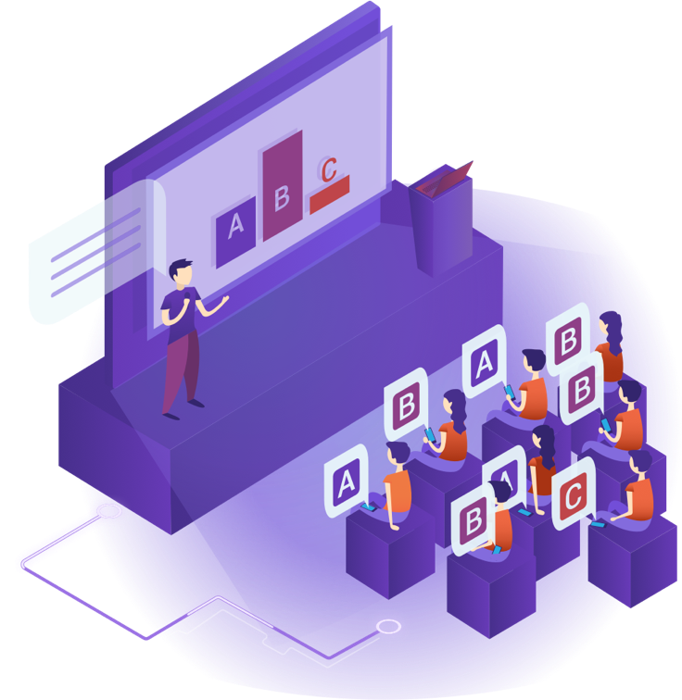


SUCCESS THROUGH PRESENTATIONS
CREATE
Company-wide slide library
slidelizard.com/creator
INTERACT
Live interaction with polls and quizzes
slidelizard.com/live
ANALYZE
360° analysis of participants & presentations
slidelizard.com/insights

